Slide 1
Diagnostic Microbiology
Reference: Laboratory Procedures for Veterinary Technicians 5th ed
(Hendrix & Sirois)

Slide 2
Microbiology: The study of microbes
Microbes: organisms too small to be seen with the unaided eye
Bacteriology, mycology, and virology are the studies of bacteria, viruses, and fungi, respectively.
Most microbes found on and in the body are nonpathogenic (i.e. normal flora)
Samples collected from locations, such as the spinal column, blood, and the urinary bladder should be free of normal flora.
Microbes considered normal flora and nonpathogenic when found in one location can produce significant disease in a site where they should not reside.

Slide 3
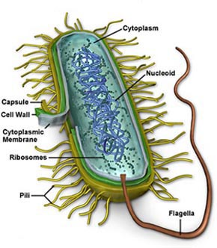
Bacterial Morphology
Bacteria: small prokaryotic cells that range in size from 0.2 to 2.0 micrometers
Most cellular organelles absent except cell walls, plasma membranes, and ribosomes
Bacteria have specific requirements for temperature, pH, oxygen tension, and nutrition
Majority of clinically significant bacterial species require a pH of 6.5 to 7.5.

Slide 4
Bacterial Morphology
Obligate aerobes: bacteria that require oxygen to survive.
Obligate anaerobes: bacteria killed in the presence of oxygen or whose growth is inhibited in the presence of oxygen
Faculative anaerobes: bacteria that can survive in the absence of oxygen but with limited growth.
Microaerophilic bacteria prefer reduced oxygen tension.
Capnophilic bacteria require high levels of carbon dioxide.

Slide 5
Bacteria Requirements
Nutritional requirements vary among bacteria
  Affect the type of culture media chosen
  Fastidious microbes have very strict requirements
Temperature requirements
  Nearly all pathogenic bacteria grow best at 20 - 40⁰ C
    referred to as mesophiles
  Bacteria with lower and higher temperature requirements referred to as psychrophiles and thermophiles, respectively.

Slide 6
Bacterial Morphology
Bacteria are organized into four groups according to shape.
Coccus (cocci) – spherical cells
Bacillus (bacilli) – rods or cylinders
Spiral – usually occur singly and can be subdivided into loose, tight, and comma shaped
Pleomorphic – shape ranging from cocci to rods

Slide 7
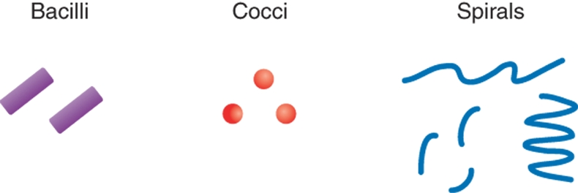
Figure 4-1 Bacterial cell shapes.
Copyright © 2007 by Mosby, Inc., an affiliate of Elsevier Inc.

Slide 8
Bacterial Arrangements
Some occur singly, such as spirilla (spirillum) and most bacilli (bacillus).
Some occur in pairs (diplococci)
Some occur in clusters, bunches, or groups
Some can be arranged in a palisade or a “Chinese Letter” pattern

Slide 9
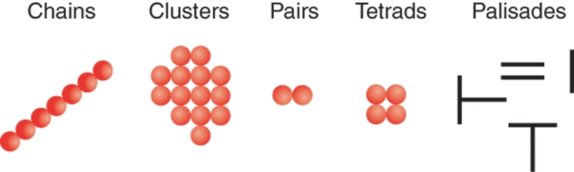
Figure 4-2 Bacterial cell arrangements.
Copyright © 2007 by Mosby, Inc., an affiliate of Elsevier Inc.

Slide 10
Bacterial Endospores
A few genera of bacteria form intracellular refractile bodies called endospores or, more commonly, spores.
Organisms in the genera Bacillus and Clostridium are spore formers.
Bacterial spores are resistant to heat, desiccation, chemicals, and radiation.

Slide 11
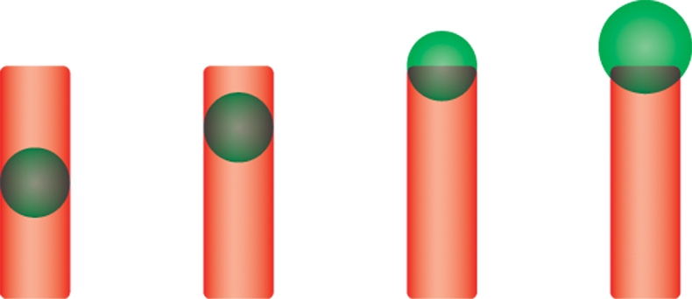
Figure 4-3 Bacterial endospores.
Copyright © 2007 by Mosby, Inc., an affiliate of Elsevier Inc.

Slide 12
Bacterial Endopores
Spores vary in size, shape, and location in the cell and may be subclassified:
  Central: present in the center of the cell, such as Bacillus anthracis.
  Subterminal: present near the end of the cell, such as Clostridium chauvoei.
  Terminal: present at the end or pole of the cell, such as Clostridium tetani.
Performing a special spore stain may not be necessary because the endospores can usually be visualized as nonstaining, bodies with Gram stain.

Slide 13
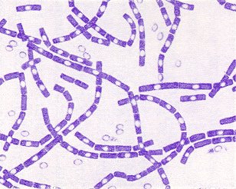
Bacterial Endopores

Slide 14
Bacterial Growth
Bacterial cells contain a single DNA strand and reproduce primarily by binary fission.
Bacterial growth proceeds through four distinct phases: lag phase, exponential growth phase, stationary phase, and logarithmic decline phase.
Rate of growth during exponential growth phase often referred to as doubling time or generation time.

Slide 15
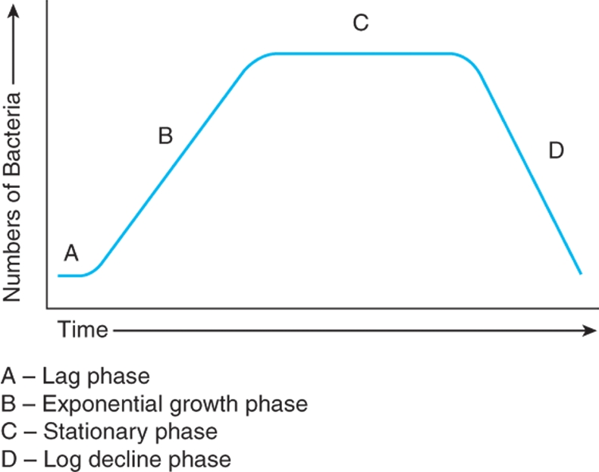
Figure 4-4 Generalized bacterial growth curve.
Copyright © 2007 by Mosby, Inc., an affiliate of Elsevier Inc.

Slide 16
Equipment and Supplies
Laboratory should be a separate room away from the main traffic areas of the clinic for microbiologic procedures.
  Adequate lighting and ventilation
  Washable floor with limited traffic
  At least two work areas (one for processing samples and one for culture work)
  Smooth surfaces that are easy to disinfect
  Electrical outlets
  Ample storage space
  Easy access to incubator and refrigerator

Slide 17
Laboratory Safety
Treat all specimens as potentially zoonotic and pathogenic.
Personnel must wear personal protective equipment when handling patient specimens to prevent contamination of clothes and spreading pathogens to general public.
Disposable gloves are required in the microbiology lab; face masks may be needed if production of aerosol particles is likely.

Slide 18
Laboratory Safety
Wash laboratory coats at least once a week in hot water and bleach.
Remove all personal protective equipment before leaving the lab.
Wash hands thoroughly.
Decontaminate or dispose of materials appropriately.
Disinfect bench tops with 70% ethanol or dilute bleach solution at the beginning and end of each work period.
Wipe down all other surfaces daily.

Slide 19
Laboratory Safety
Spilled cultures are treated with disinfectant and allowed contact for 20 minutes prior to being cleaned up.
Flame non-disposable wire loops immediately after use.
Eating, drinking, handling contact lenses and applying cosmetics are not permitted in a microbiology lab.
Tie back long hair or tuck inside lab coat.
Promptly report all accidents to lab supervisor or veterinarian.

Slide 20
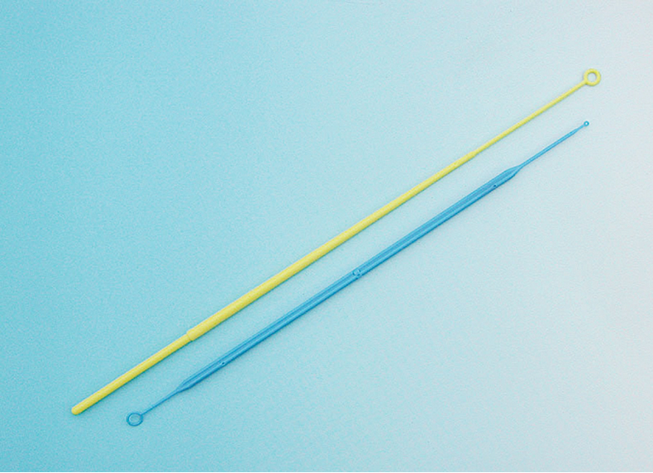
Figure 4-6 Disposable plastic inoculating loops.
(Courtesy of B. Mitzner, DVM.)

Slide 21
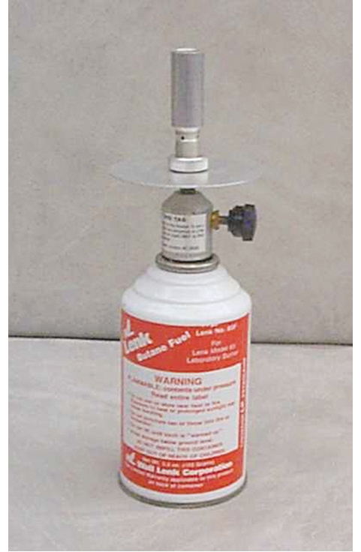
Figure 4-7 Propane burner for sterilizing metal inoculating loops.
(Courtesy of B. Mitzner, DVM.)

Slide 22
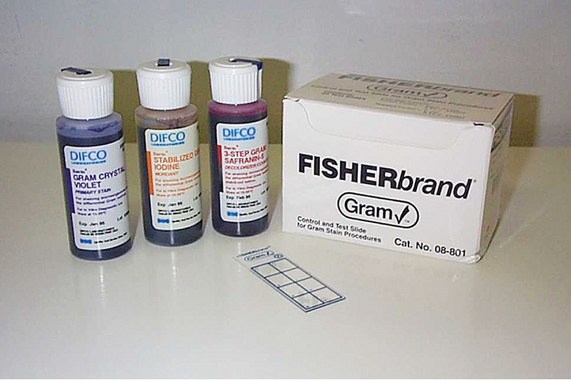
Figure 4-8 Gram stain kit.
(Courtesy of B. Mitzner, DVM.)

Slide 23
Staining of Microbiology Samples
Samples taken directly from patients are often Gram stained before being cultured.
Information obtained from direct smear may help determine:
  Suitability of the specimen for identification
  The predominant organism in a mixed specimen
  Appropriate medium for culture
  Appropriate antibacterials for sensitivity testing

Slide 24
Gram Staining Procedure
Swab specimens may be rolled lightly onto the slide.
Touching the sterile wire to one colony on the plate is usually sufficient to obtain enough bacteria for application to the slide.
Colonies should be young (24-hour culture) because older colonies may not yield proper results and the stained bacteria often become excessively decolorized.

Slide 25
Gram Staining Procedure
Bacterial samples from plates are gently mixed in a drop of water or saline on the slide.
Samples may be obtained from inoculated broth by spreading two to three loopsfull onto the slide.
Sample may be smeared directly onto a slide, such as from tissue or an abscess.
Sample droplet on slide may be encircled with wax pencil to help find area after staining.

Slide 26
Gram Staining Procedure
After the material has dried on the slide, it is heat fixed by passing the slide through a flame two or three times, specimen side up.
    Prevents sample from washing off, helps preserve cell morphology, and kills the bacteria, rendering them permeable to stain.
Slide is placed on a staining rack over a sink.
Crystal violet solution is poured onto the smear and allowed to stand for 30 seconds.
Slide is rinsed gently with water (tap water is acceptable).

Slide 27
Gram Staining Procedure
Iodine solution is poured onto the smear and allowed to stand for 30 seconds.
Slide is gently rinsed with water
Smear is washed with decolorizer until no purple washes off (usually <10 seconds)
Slide is rinsed with water and replaced on rack.
Basic fuchsin or safrain is poured on the smear and allowed to stand for 30 seconds.
Smear is rinsed again with water.
Smear is air dried or blotted dry.

Slide 28
Gram Staining Procedure
Smear is examined microscopically with the 100x oil-immersion objective.
Bacteria that retain the crystal violet-iodine complex and stain purple are gram positive
Bacteria that lose the crystal violet or purple color and stain red are gram negative.
To ensure proper staining quality, stain known (control) gram-positive and gram-negative organisms at least once per week and with each new batch of stain.

Slide 29
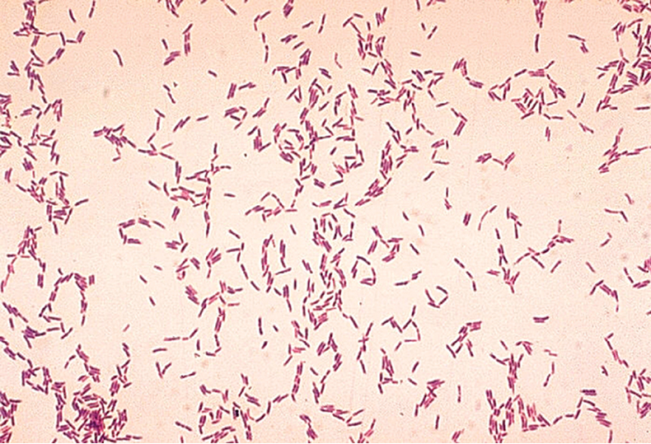
Figure 4-9 Typical staining pattern of gram-positive Actinomyces bacteria.
(Courtesy Public Health Image Library, PHIL#6711, William A. Clark, Atlanta, 1977, Centers for Disease Control and Prevention.)

Slide 30
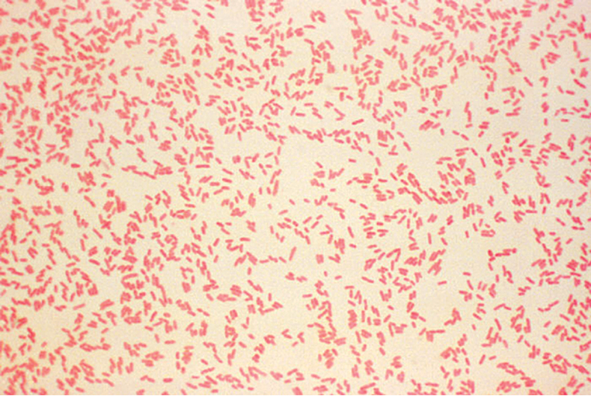
Figure 4-10 Typical staining pattern of gram-negative Yersinia bacteria.
(Courtesy Public Health Image Library, PHIL#6711, Atlanta, 1980, Centers for Disease Control and Prevention.)

Slide 31
Potassium Hydroxide (KOH) Test
Used when a gram-variable reaction occurs.
A loopful or two of 3% KOH solution is placed on a slide.
A generous quantity of surface growth is removed from the culture and transferred to the drop of KOH.
Specimen is stirred into the KOH drop with a loop; the loop is slowly and gently lifted.
After a max. of 2 mins. of stirring (~30 secs.), gram-negative organisms develop a mucoid appearance and produce a sticky strand when the drop is lifted with the loop.
If the organisms are gram positive, the mixture stays homogeneous and does not form a strand on lifting.

Slide 32
Other Microbiology Staining Procedures
Acid Fast Stain
  Used primarily to detect Mycobacterium and Nocardia species.
  Contain several solutions, including a primary stain (typically dimethyl sulfoxide – DMSO and carbol fuchsin), an acid-alcohol decolorizer, and a counterstain, such as NMB.
  After final rinse, if color remains, the organism is “acid-fast” and appears red, whereas, non-acid fast microorganisms stain blue.

Slide 33
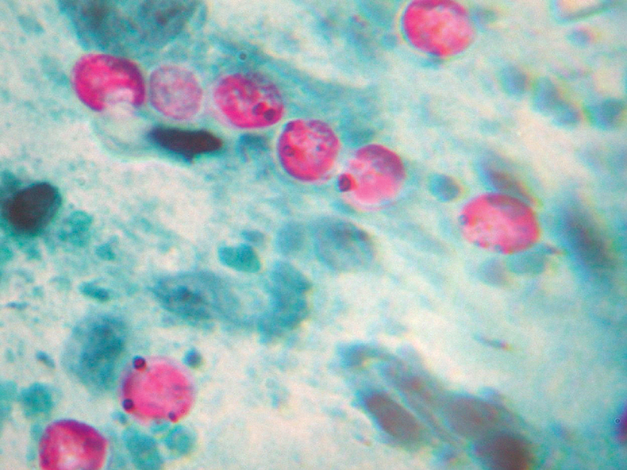
Figure 4-11 Acid-fast stain of Mycobacterium.
(Courtesy of Marc Kramer, DVM, Avian and Exotic Animal Medical Center, Miami, FL.)

Slide 34
Other Microbiology Staining Procedures
Giemsa Stain
  Used to detect spirochetes and rickettsiae and to demonstrate the capsule of Bacillus anthracis.
  Smear is fixed in absolute methanol for 3 to 5 minutes and air dried.
  Then, smear is dipped in diluted stain for 20 – 30 minutes.
  Bacteria stain purplish-blue.

Slide 35
Other Microbiology Staining Procedures
Specialized Stains
  Have limited application in the average veterinary practice
  Flagella stains
    Usually contain crystal-violet
    Are used to detect and characterize bacterial motility
    Usually expensive; there are other methods of testing motility
  Capsule stains
    Used for detection of pathogenic bacteria
      All bacteria that contain capsules = pathogenic
      Not all pathogenic bacteria contain capsules
    Requires use of bright-field phase contrast microscopy

Slide 36
Other Microbiology Staining Procedures
  Endospore stains
    Bacterial spores contain protein coats of keratin that make them resistant to most normal staining procedures.
    Detect presence, location, and shape of spores
    Older culture is used (>48 hours)
    Involves addition of malachite green to specimen and counterstaining with safranin or basic fuchsin
    Spores appear dark blue/green with the remainder of bacterial cell pink or red.
  Fluorecent stains
    Used primarily for identification of Legionella and Pseudomonas
    Expensive.

Slide 37
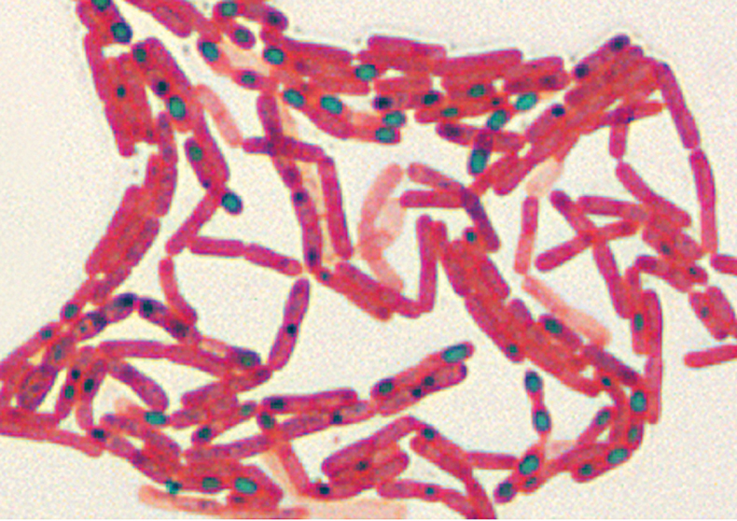
Figure 4-12 Malachite green endospore stain of Bacillus anthracis.
(From Songer JG, Post KW: Veterinary microbiology: bacterial and fungal agents of animal disease, St Louis, 2005, Saunders.)

Slide 38
Culture Media
Culture media: any material, solid or liquid, that can support the growth of a microorganism.
  Available as dehydrated powder or as prepared agar plates or ready-to-use liquid media for biochemical tests.
  Solidifying agents used in preparing solid media include agar and gelatin
    Agar - dried extract of sea algae known as agarphytes
    Gelatin – protein obtained from animal tissues.
    Keep agar plates refrigerated at 5⁰ C to 10⁰ C and away from internal walls of refrigerator.

Slide 39
Culture Media
Six types of culture media include transport, general purpose, enriched, selective, differential, and enrichment.
Some media contain characteristics of more than one type.
Common laboratory media are optimized to support growth of many, but not all pathogens. Occasionally, strains of common organisms grow poorly, if at all, in the lab.

Slide 40
Culture Media
General Purpose Media, or nutrient media, is not commonly used in veterinary practice.
Enriched media are formulated to meet the requirements of the most fastidious pathogens.
  Basic nutrient media with extra nutrients added such as blood, sermum, or egg
  Examples: blood agar and chocolate agar
Selective media contain antibacterial substances such as bile salts or antimicrobials that inhibit or kill all but a few types of bacteria
  Example: MacConkey agar

Slide 41
Culture Media
Differential media allow bacteria to be differentiated into groups by biochemical reactions on the media
  Example: Simmons citrate
Enrichment media are liquid media that favor growth of a particular group of organisms
  Contains nutrients that encourage growth of the desired organisms or contain inhibitory substances that suppress competitors.
  Examples: Tetrathionate broth and selenite broth

Slide 42
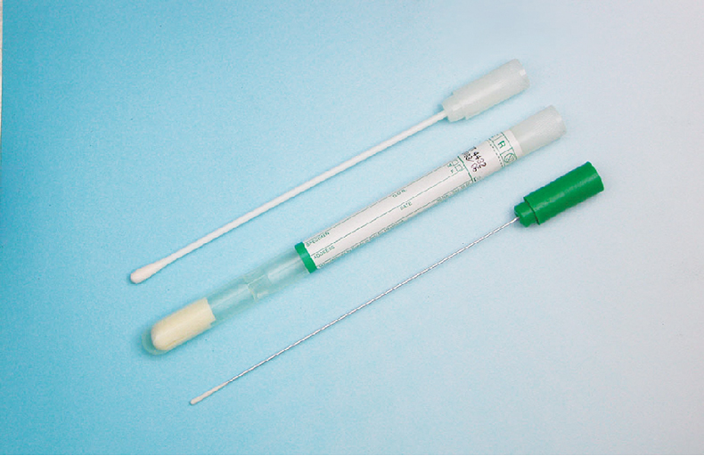
Culture Media
Transport media is designed to keep microbes alive while not encouraging growth and reproduction
  Culturette used for specimen collection contains prepared transport media

Slide 43
Blood Agar
An enriched medium that supports the growth of most bacterial pathogens
Trypticase soy agar with sheep blood is most common type.
Blood agar acts as an enrichment medium and a differential medium because four distinct types of hemolysis can be detected:
  Alpha hemolysis – partial hemolysis that creates a narrow band of greenish or slimy discoloration around colony.
  Beta hemolysis – complete hemolysis that creates a clear zone around the bacterial colony
  Gamma hemolysis – produces no change in the appearance of the medium and no hemolysis around colonies
  Delta hemolysis – zone of hemolysis surrounded by a narrow zone of hemolysis around a colony (aka – double-zone hemolysis)

Slide 44
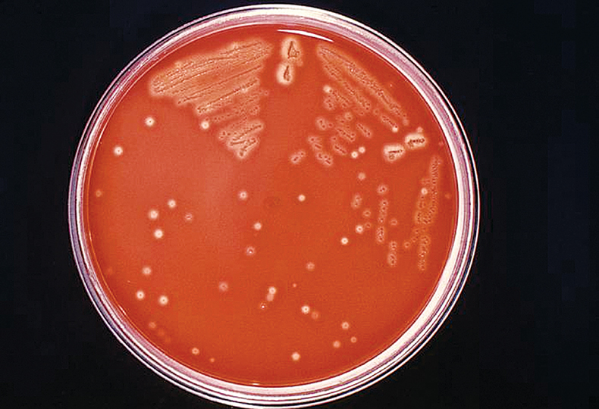
Figure 4-13 Alpha hemolysis of Streptococcus on blood agar.
(Courtesy Public Health Image Library, PHIL#8170. Richard R. Facklam, Atlanta, 1977, Centers for Disease Control and Prevention.)

Slide 45
MacConkey Agar and EMB agar
MacConkey agar and Eosin-methylene blue agar are selective and differential media.
MacConkey agar contains crystal violet, which suppresses growth of gram-positive bacteria. Because it also contains bile salts, it is selective for bacteria that can grow in the presence of bile salts, which is similar to the environment found in the intestines.
EMB media perform the same function and can identify lactose-fermenting organisms.

Slide 46
Thioglycollate Broth
Liquid medium used to culture anaerobic bacteria and determine the oxygen tolerance of microbes
Contains stable oxygen gradient, with high concentrations of oxygen near the surface and anaerobic conditions near the bottom.
Obligate aerobes will grow only in top layer; obligate anaerobes will grow only in bottom.
Facultative anaerobes can grow throughout but usually grow in middle between the zones.
Primarily used in veterinary practice as enrichment media and for blood cultures.

Slide 47
Other Culture Media
Urea tubes
  Urea slants should be streaked with inoculum and incubated overnight at 37⁰ C.
  Urease-positive bacteria produce a pink-red color change due to hydrolysis of urea; urease-negative remains yellow.
Sulfide-indole motility tubes
  Hydrogen sulfide production is indicated by blackening of medium
  Add 5 drops of Kovac’s reagent for indole testing.
  Indole test media detect the ability of bacteria to produce indole as one of the degradation products of tryptophan metabolism.
  If positive, a red-ring forms around top of medium.
  Inoculate with straight stab (1 in.); remove wire along line of entry

Slide 48
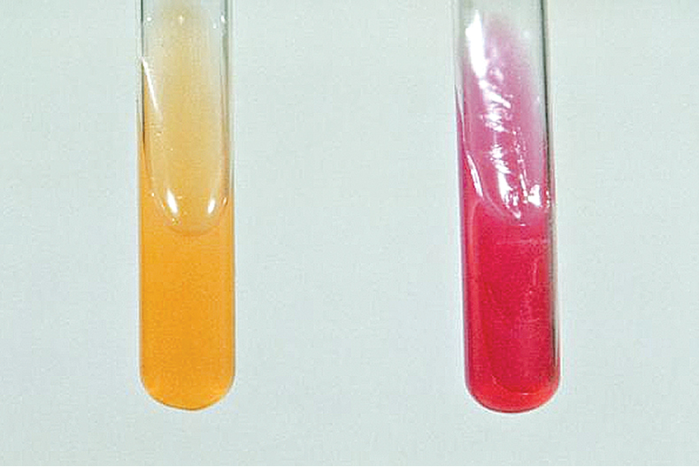
Figure 4-14 Urea tubes. The pink coloration indicates a positive reaction, (urea hydrolysis). Yellow indicates a negative reaction.
(Courtesy Public Health Image Library, PHIL#6711, Atlanta, 1976, Centers for Disease Control and Prevention.)

Slide 49
Other Culture Media
Simmons citrate tubes
  Differentiate bacteria according to use of citrate
  Slant surface is inoculated
  Bacterial use of citrate in medium imparts a deep blue color; unchanged medium is green.
Triple-sugar-iron agar
  Composite medium used for presumptive identification of salmonellae and initial differentiation of enteric bacteria.
  Contains an indicator system for hydrogen sulfide production and pH indicator, phenol red, which colors uninoculated medium red.

Slide 50
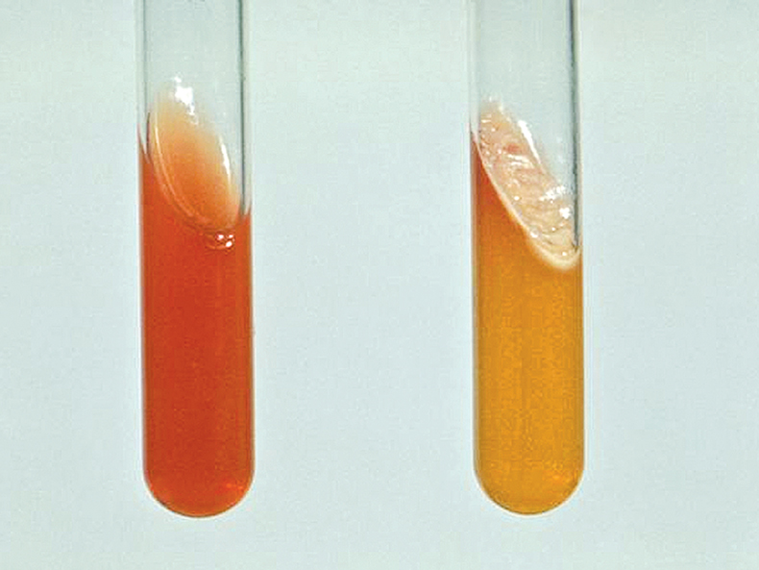
Figure 4-15 Triple sugar iron agar is used to classify bacteria according to their ability to ferment glucose, lactose, or sucrose, as well as produce hydrogen sulfide. A yellow result indicates fermentation; the reddish result indicates no fermentation.
(Courtesy Public Health Image Library, PHIL#6710, Atlanta, 1976, Centers for Disease Control and Prevention.)

Slide 51
Other Culture Media
Brain-heart infusion broth
  General-purpose broth used to increase the number of organisms (pre-enrichment) before they are planted on solid medium
  For culture of blood samples, approximately 1 ml of blood is added to nutrient broth or a special blood culture medium
  Blood contains many substance inhibitory to bacteria; adding blood sample directly to broth dilutes the effect of these natural inhibitors.
Mannitol salt agar
  Not routinely used; a highly selective medium, can be used to isolate Staphylococcus aureus from contaminated specimens.

Slide 52
Other Culture Media
Bismuth sulfate agar
  Selective medium; suppresses growth of coliforms while permitting growth of salmonellae.
Sabourand dextrose and bismuth-glucose-glycine yeast media
  Used specifically for the culture of fungi and yeast.
Mueller-Hinton
  General purpose media primarily used for the performance of the agar diffusion antimicrobial sensitivity test.

Slide 53
Combination and Modular Culture Media
Bullseye and Target systems
  Five-chambered agar plates containing selective and nonselective media plus a central area with Mueller-Hinton agar for sensitivity testing.
“Dipslides” or “Paddle” media (Uridip® or Solarcult®)
  Useful tools for UTI screening; made with a variety of media combinations; most common ones have either MacConkey or EMB and cystine lactose electrolyte-deficient agar.
Enterotubes
  Commercially available microbiology test kits incorporating multiple types of media designed to provide differentiation of enteric bacteria based on biochemical reactions on the media.

Slide 54
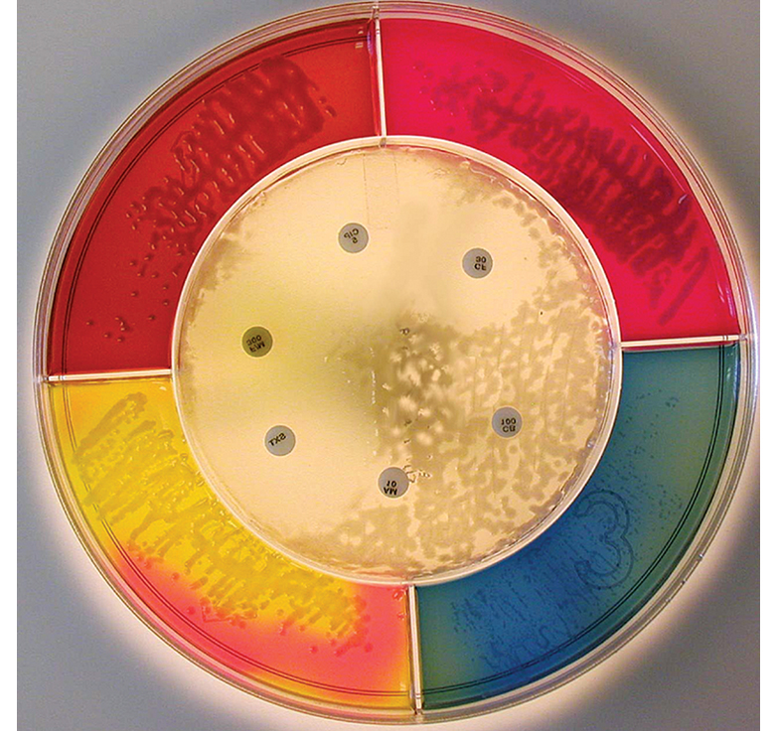
Figure 4-16 Bull’s Eye culture media.
(Courtesy Healthlink, Jacksonville, FL.)

Slide 55
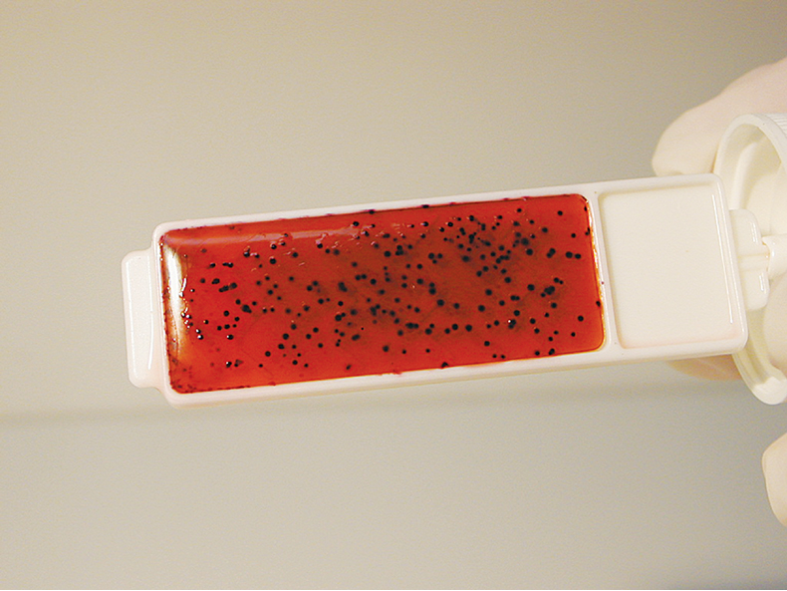
Figure 4-17 Solar-Cult media used for screening patients for urinary tract infections.
(Courtesy Solar Biologicals, Ogdensburg, NY.)

Slide 56
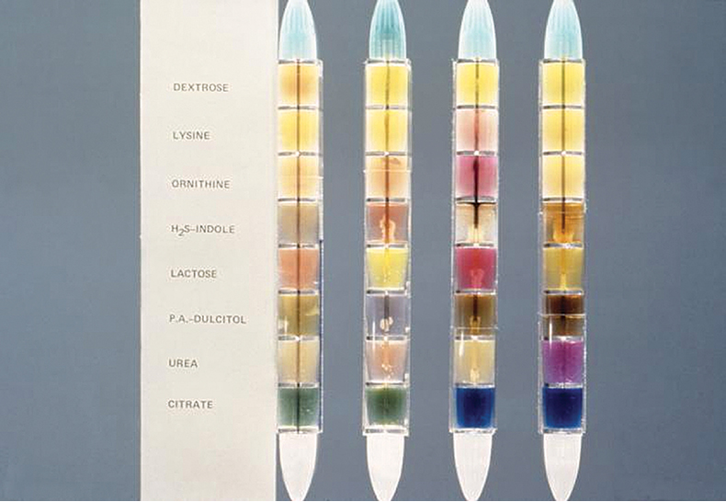
Figure 4-18 The Enterotube is a multitest system containing eight different agar preparations.
(Courtesy Public Health Image Library, PHIL#5421, Theo Hawkins, Atlanta, 1977, Centers for Disease Control and Prevention.)

Slide 57
Quality Control Cultures
Monitor procedures and supplies for quality and accuracy, including antibacterial susceptibility tests, media, biochemical tests, and certain tests for identification.
A selection of control organisms can be obtained on disks.
Bacteria can be stab inoculated into a tube of medium and subcultured every ~2 months.

Slide 58
Quality Control Cultures
Streptococcus, Pasturella, and Actinobacillus species die quickly on culture plates.
Streptococci can be kept in a test tube of cooked meat broth and subcultured every ~4 weeks.
Pasturella and Actinobacillus spp. Remain viable if mixed with approximately 0.5 ml of whole blood in a small tube and stored in a deep freeze at -10⁰ C or lower.
Control cultures can be kept at room temperature in screw-capped tubes but preferably in a refrigerator at 4⁰ C, which reduces the metabolic rate of the organisms.

Slide 59
Specimen Collection
Aseptic technique is critical to achieving diagnostic-quality results!
Various methods are acceptable, including: aspiration, swabbing, scraping, depending on the type of lesion and location on animals body.
Samples to be processed immediately can be collected with sterile cotton swabs:
  Contamination risk is high
  Cotton can inhibit microbial growth
  Oxygen can become trapped in fibers, making recovery of anaerobic bacteria less likely.

Slide 60
Specimen Collection
If delays in processing sample are expected, a rayon swab in transport media (Culturette) may be used to preserve quality of sample.
Specimen selected must contain organism causing the problem
Normal flora and contaminants may complicate sample collection and subsequent interpretation of results.
Better results will be obtained if specimens are collected from sites that would normally be sterile; infections are likely to be caused by a single, predominant organism.

Slide 61
Primary Identification of Bacteria
Systematic approach needed to identify pathogenic bacteria.
Flow charts of bacteria seen most often and the tests used to differentiate those bacteria can be used.
Specimens are first streaked onto a primary medium, such as blood agar and MacConkey agar.
Plates are incubated for 18 to 24 hours and examined for growth.
Further identify suspected pathogens on the incubated plate regarding genus and/or species with the flow chart.

Slide 62
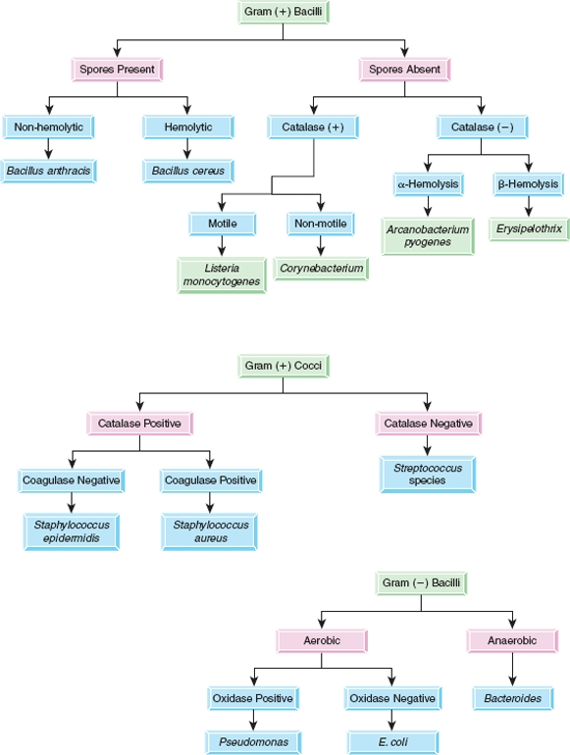
Figure 4-19 Examples of flow charts used for differentiation of bacteria.
Copyright © 2007 by Mosby, Inc., an affiliate of Elsevier Inc.

Slide 63
Primary Identification of Bacteria
Most gram-positive and gram-negative organisms grow on blood agar.
Gram-positive organisms usually do not grow on MacConkey agar, but it can support growth of most gram-negative organisms.
Selection of the colony from the routine blood agar plate is preferable rather than from MacConkey agar.

Slide 64
Inoculation of Culture Media
Use aseptic technique at all times!
Culture plates are kept closed unless inoculating or removing colony specimens for testing.
When transferring samples from or to a tube, pass the tube neck through a flame before and after transfer of material and avoid putting the cap down.
When flaming an inoculation loop or wire, place the near portion of the wire in the flame first and then work toward the contaminated end.

Slide 65
Inoculation of Culture Media
When the specimen collected is a liquid, a small quantity of well-mixed sample is inoculated at the edge of the plate with a sterile swab or bacteriologic loop.
Pre-sterilized glass rods may be used for streaking samples; disposable inoculating loops and wires are also available.
If the specimen has been initially collected on a sterile swab, this is streaked directly on the plate.

Slide 66
Quadrant Streak Method
Use a sterile bacteriologic loop to remove a small amount of the bacterial colony from culture plate or loopful from a broth culture.
Hold loop horizontally against surface of agar to avoid digging into the medium when streaking the inoculum.
Lightly streak one quadrant (QA), using a back-and-forth motion, keeping each streak separate.
Pass the loop through a flame and allow it to cool.
Place inoculating loop on the edge of Quad A and extend streaks into Quad B, using back-and-forth motion, keeping each streak separate.

Slide 67
Quadrant Streak Method
Pass the loop through a flame and allow it to cool.
Place inoculating loop on the edge of QB and extend streaks into QC using a back-and-forth motion (do not overlap)
Pass the loop through a flame and allow it to cool.
Place inoculating loop on the edge of QC and extend streaks into QD using a back-and-forth motion (do not overlap)
Use entire plate and keep streak lines close together to include as many streaks as possible, taking care not to overlap the other streaks and avoid depositing excessive numbers of bacteria in an area.

Slide 68
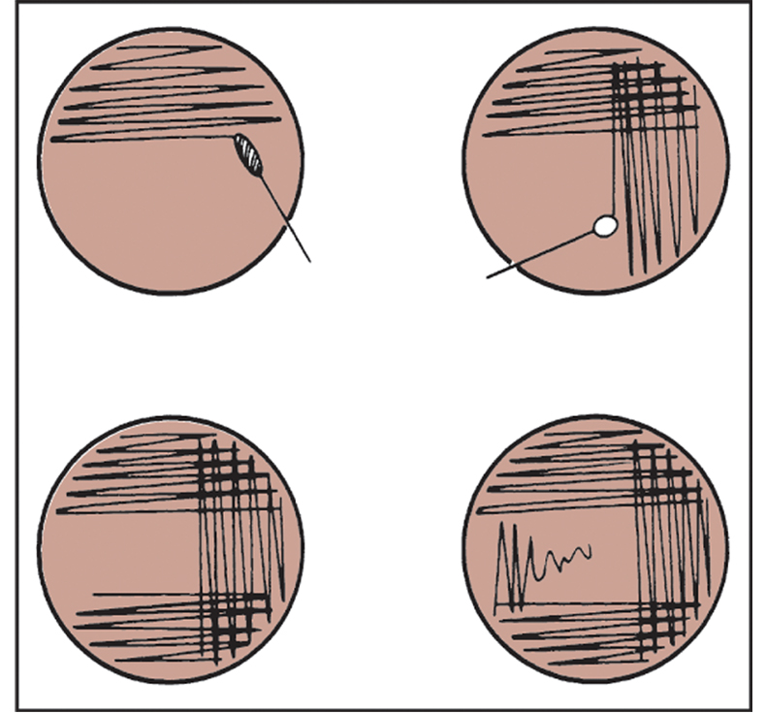
Figure 4-20 Quadrant streak method for isolation of bacteria.
(From McCurnin DM, Bassert JM: Clinical textbook for veterinary technicians, ed 6, St Louis, 2006, Saunders.)

Slide 69
Inoculation of Culture Media
If several types of colonies grow on the plate, each colony is subcultured onto separate plates and the procedure repeated until a pure culture is obtained.
When using tube media, either surface of slant is inoculated or the butt and slant may be inoculated
  Butt first
  “S” shaped streak on slant surface

Slide 70
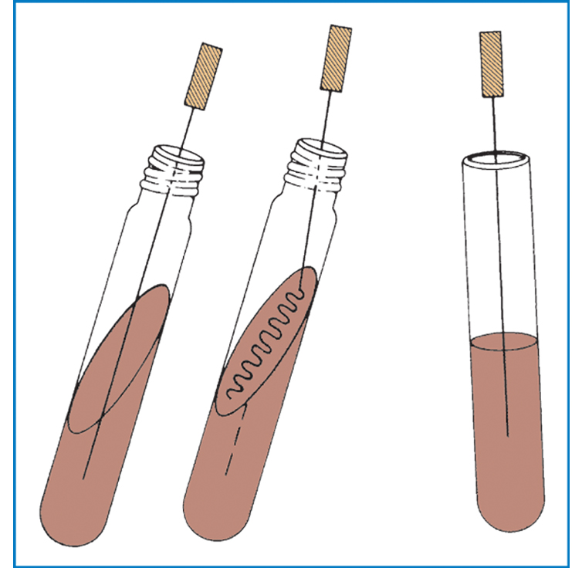
Figure 4-21 Inoculation procedure for tube media. A, Inoculation of agar slant and butt, such as triple sugar iron. B, Inoculation of motility test media.
(From McCurnin DM, Bassert JM: Clinical textbook for veterinary technicians, ed 6, St Louis, 2006, Saunders.)

Slide 71
Incubation of Cultures
For pathogens that can invade internal organs of an animal, the optimal growth temperature is usually near 37⁰ C.
For some skin pathogens (such as dermatophytes), and environmental organisms, the optimal growth temperature is lower.
Incubation time depends on the generation time of individual bacterial species and the type of medium on which they are growing.

Slide 72
Incubation of Cultures
For routine cultures, incubate plates for 48 hours and examine after 18 to 24 hours of incubation.
Invert culture plates during incubation so that moisture does not collect on surface of agar, which may cause clumping of colonies.
Some pathogens require carbon dioxide for growth in the culture atmosphere; a candle jar may be used.

Slide 73
Colony Characteristics
Help to identify the bacterium involved and include:
  Size (In millimeters; described as pinpoint, medium, large)
  Pigment (color; grey, yellow, white, creamy, black….)
  Density (opaque, transparent)
  Elevation (raised, flat, convex, drop-like)
  Form (circular, irregular, rhizoid, filamentous, undulate)
  Texture (glassy, smooth, mucoid, buttery, brittle, sticky)
  Odor (sweet, pungent, etc.)
  Hemolysis (alpha, beta, gamma, delta, none)

Slide 74
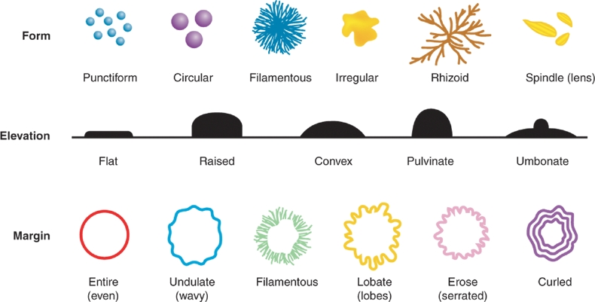
Figure 4-22 Bacterial colonies may be described on the basis of their form, elevation, and margins.
Copyright © 2007 by Mosby, Inc., an affiliate of Elsevier Inc.

Slide 75
Culture of Anaerobes
Acceptable anaerobic specimens include blocks of tissue (2-inch cube minimum) in a closed, sterile container and pus and exudate collected in a sterile syringe, with air expelled and the needle plugged with a rubber stopper or bent backward on itself.
Specialized anaerobic specimen collection systems are also available.
Culture specimens as soon as possible after collection
Specimen inoculated onto blood agar plate and into thioglycollate broth
Blood agar plates put into anaerobe jar or a self-contained system, such as a Gas Pack.

Slide 76
Additional Bacterial Testing
Usually the genus of pathogenic organisms can be determined using just staining and culture characteristics (presumptive or tentative identification).
Some organisms must be further differentiated to species level and require additional testing.
Some additional bacterial testing methods include: motility, catalase, coagulase, oxidase, and acid production from glucose.

Slide 77
Antibiotic Sensitivity Testing
Performed to determine the susceptibility or resistance to specific antimicrobial drugs
Designed for rapidly growing bacteria.
Specimen used for testing is taken from animal prior to beginning pharmacologic treatment
Agar diffusion method uses paper disks impregnated with antimicrobials.
Concentration of drug in disk chosen to correlate with therapeutic levels of drug in animal being treated
Most common method is Kirby-Bauer test.

Slide 78
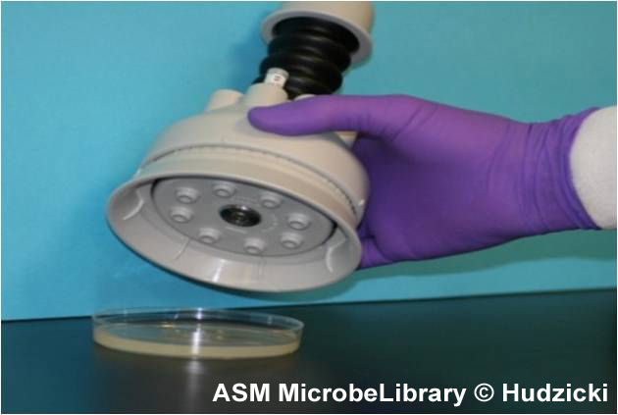
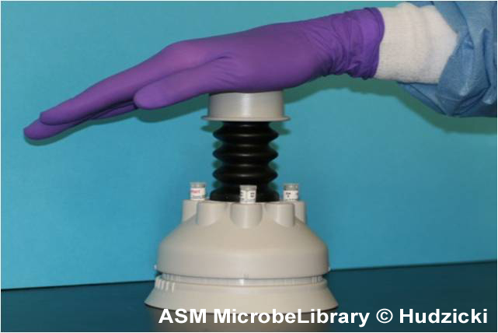
Kirby-Bauer Disk Dispenser

Slide 79
Antibiotic Sensitivity Testing
Zones of inhibition are measured to determine bacterial resistance or susceptibility to specific antimicrobial drugs.
MIC = Minimum Inhibitory Concentration; this is the smallest concentration of a specific antimicrobial that can inhibit the growth of a given bacteria.
MIC can be determined using a method similar to agar diffusion test or using a broth dilution susceptibility test.

Slide 80
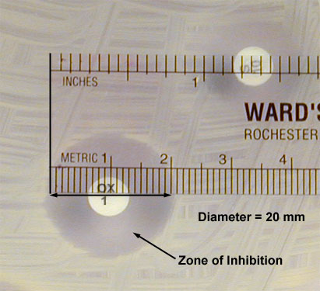
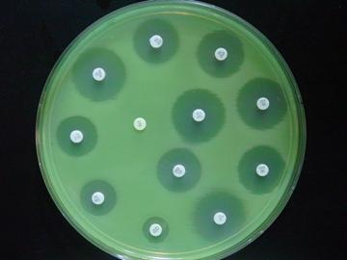
Zones of Inhibition

Slide 81
Agar Diffusion Method
Indirect sensitivity testing: colony samples are taken from the culture plate, subcultured in broth media, and incubated to achieve a turbidity that matches a standardized McFarland suspension.
Broth suspension is applied to Mueller-Hinton media with a swab or loop to cover the plate completely.
Direct sensitivity testing involves application of undiluted samples, such as urine, directly to the Mueller-Hinton plate.
  Not as precise as indirect method; reasonable results can be expected only when one organism is present.

Slide 82
Agar Diffusion Method
Antimicrobial disks are placed on the inoculated agar surface with a disk dispenser or sterile forceps that have been flamed and cooled between each use.
  Disks should be no closer than 10 to 15 mm from edge of plate.
  Separate disks from each other sufficiently to avoid overlapping zones of inhibition.
Plates are inverted and incubated aerobically at 37⁰ C and placed in the incubator within 15 minutes after placing the disks on the inoculated agar.
Plates are read after 18 to 24 hours
Prolonged incubation may alter the size of zones of inhibition or make them difficult to read.

Slide 83
Agar Diffusion Method
Determine antibiotic susceptibility by physical measurement of the inhibitory zones.
That measurement is compared to a chart of inhibitory zones to determine the relative resistance of the bacterium to the antibiotics being tested.
Diameter of the zone (including the disk) is measured from the underside of the plate by calipers, transparent ruler, or template and recorded to the nearest millimeter.

Slide 84
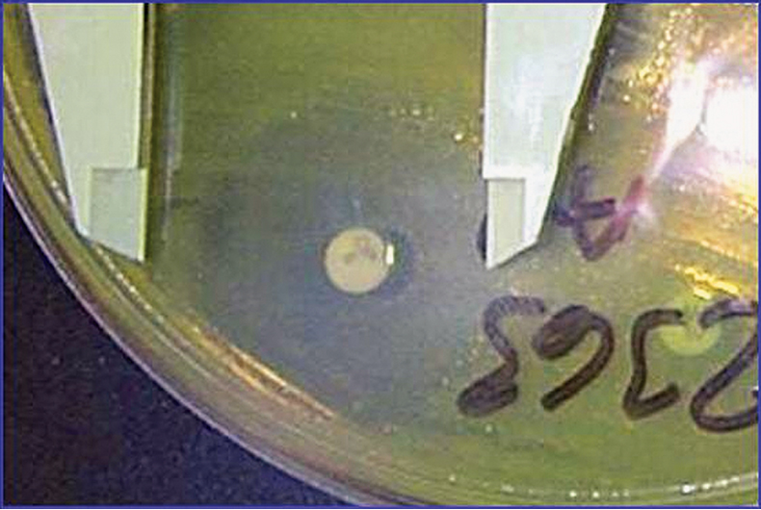
Figure 4-23 The use of a caliper to measure zone of inhibition.
(Courtesy of B. Mitzner, DVM.)

Slide 85
Agar Diffusion Method
Inhibitory zones are divided into two major categories: resistant and susceptible to the particular antimicrobial agent.
Susceptible strains are subdivided into intermediately susceptible and susceptible.
Test susceptible reference organisms regularly, preferably in parallel with each batch of antimicrobial susceptibility tests.
  Control organisms are used to check growth-supporting capability of the medium, potency of antimicrobial disks, and other variable conditions that can affect the results.

Slide 86
Urine Culture Colony Count
Presence of pathogenic bacteria does not necessarily indicate infection; small numbers of organisms may be found even in samples normally considered sterile like urine.
Colony count on cultured samples can help support a diagnosis of infection.
Performed by streaking a blood agar or other nonselective agar plate using a calibrated loop containing 10 mL of urine.
After incubation, all colonies are counted and multiplied by 100 to determine the number of colony-forming units per milliliter.

Slide 87
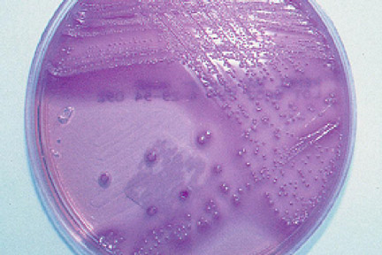
Urine Colony Count
Significant numbers of CFUs per milliliter of urine:
  Cystocentesis: >1,000
  Catheter: > 10,000
  Voided samples: >100,000 (dogs); >10,000 (cats)

Slide 88
Mastitis Testing
Mastitis is caused by bacterial or mycotic organisms.
Several laboratory tests diagnose mastitis, including the California mastitis test, somatic cell count, and milk culture.
Bacteria can be quickly detected by examining a thin smear of mastitic milk that has been heat fixed and stained with Gram stain or methylene blue.
CMT is a qualitative screening test that can be used as a “Cow-side test”

Slide 89
California Mastitis Testing
2 ml of milk is placed in each of 4 cups on the CMT paddle and an equal amount of reagent is added.
Paddle is gently rotated for ~10 sec. in a circular pattern; a score is assigned for each cup.
Test is based on gel formation when the test reagent reacts with DNA in somatic cells; as the cell count of milk increases, the gelling action increases.
Degree of gel formation scored as negative, trace, 1, 2, or 3, and y (acidic - purple) or + (alkaline - yellow)
Reaction must be scored 10 to 15 sec. after mixing starts.

Slide 90
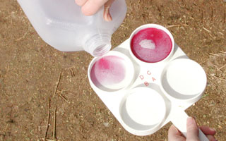
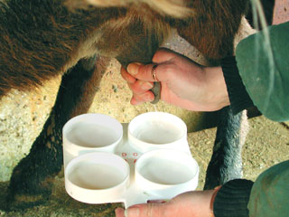
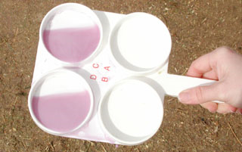
California Mastitis Test

Slide 91
Milk Culture
Positive milk samples identified by CMT should be cultured.
Milk sample inoculated on blood agar and MacConkey agar and incubated at 37⁰ C for 24 hrs
  A tube of milk sample is also incubated simultaneously
If cultures show minimal or no growth after 24 hrs., a subculture is made on the plates from the incubated tube of milk.
Subculture is incubated for an additional 24 hrs.

Slide 92
Mycology
Fungi are heterotrophs (organisms unable to synthesize metabolic products from inorganic materials; requiring complex organic substances –growth factors - for nutrition) and may be parasitic or saprophytic.
Most are multicellular (except for yeasts) and contain eukaryotic (having a true nucleus) cells with cell walls composed of chitin (similar to an exoskeleton of an insect).
Fungal organisms consist largely of webs of slender tubes called hyphae, that grow toward food sources.

Slide 93
Mycology
Fungi digest food externally, through release of digestive enzymes, and then bring the resulting small molecules into the hyphae.
Hyphae make up a branching web called a mycelium.
Fungal organisms may also have a reproductive structure called a fruiting body that produces and releases reproductive cells called spores.

Slide 94
Mycology
Different groups of fungi produce different types of spores.
  Yeasts reproduce by budding rather than by spore formation.
Most fungi rely on sexual and asexual reproductive systems
Asexual spores produced by some fungi are sporangiospores or conidia.
Sexual spores include ascospores, basidiospores and zygospores.

Slide 95
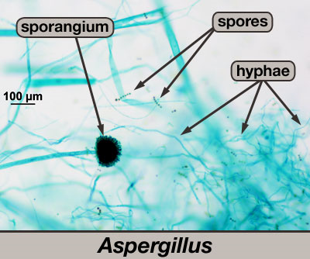
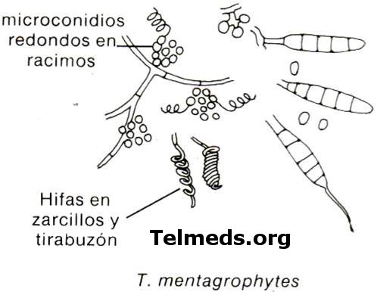
Fungal Terminology
Macroconidia
Microconidia
Hyphae
Mycelium is a web of hyphae

Slide 96
Mycology
Pathogenic fungal organisms are categorized into four groups on the basis of type of reproductive structures.
  Basidiomycetes: mushrooms or club fungi
  Ascomycetes: cup fungi
  Zygomycetes: mold
  Deuteromycetes: also known as fungi imperfecti; no known sexual stage occurs.

Slide 97
Dermatophytes
Dermatophytes are cutaneous mycotic organisms; often referred to as the ringworm fungi because of the characteristic circular lesions on the skin of infected animals.
They are saprophytic mycelial-forming fungi posess keratolytic properties, allowing them to invade skin, nails, and hair.
Dermatophytes are composed of more than three dozen organisms in the taxonomic genera Microsporum and Trichophyton.

Slide 98
Dermatophyte Testing
Some dermatophytes can be visualized microscopically by mounting a few plucked hairs in a few drops of 10% potassium hydroxide (can add DMSO) then applying a coverslip and examining microscopically after 2 to 10 min. for small globular arthrospores attached to hair shafts.
A Wood’s Lamp may be used to screen suspect lesions.
  Some species of Microsporum may fluoresce a clear apple green under the lamp in a darkened room.

Slide 99

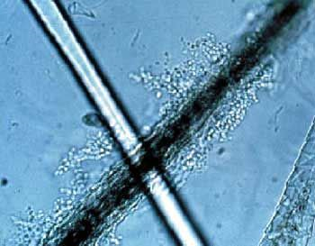
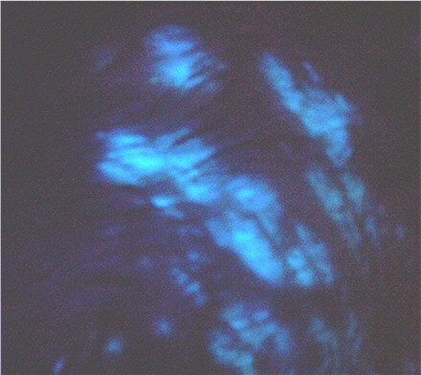
Dermatophyte Testing

Slide 100
Dermatophyte Testing Products
Several products available for culturing dermatophytes.
Most common is standard DTM medium
  An indicator that turns red in the presence of most dermatophytes
Rapid sporulation medium or ESM and Standard Sabouraud dextrose agar are also available.

Slide 101
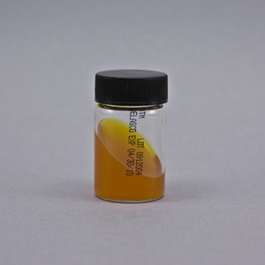
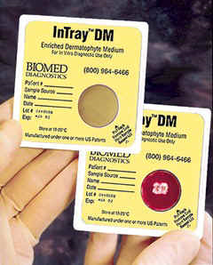
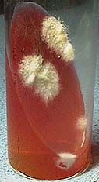
Dermatophyte Culture Media

Slide 102
Dermatophyte Testing Procedure
Clean skin lesion to remove surface contamination and collect specimens from lesion periphery.
  Broken hair shafts and dry scale most likely to contain viable organisms.
Push specimens into and partially below the surface of the media and incubate the culture at room temperature with the cap or plate cover loosened; observe daily for growth.
Examine any growth microscopically with clear cellophane tape and lactophenol cotton blue stain to confirm the presence of pathogenic forms.

Slide 103
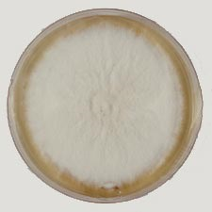
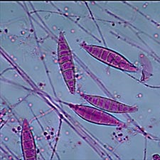
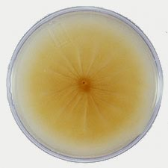
Microsporum canis

Slide 104
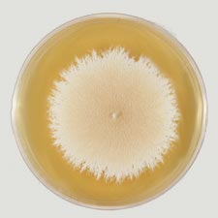
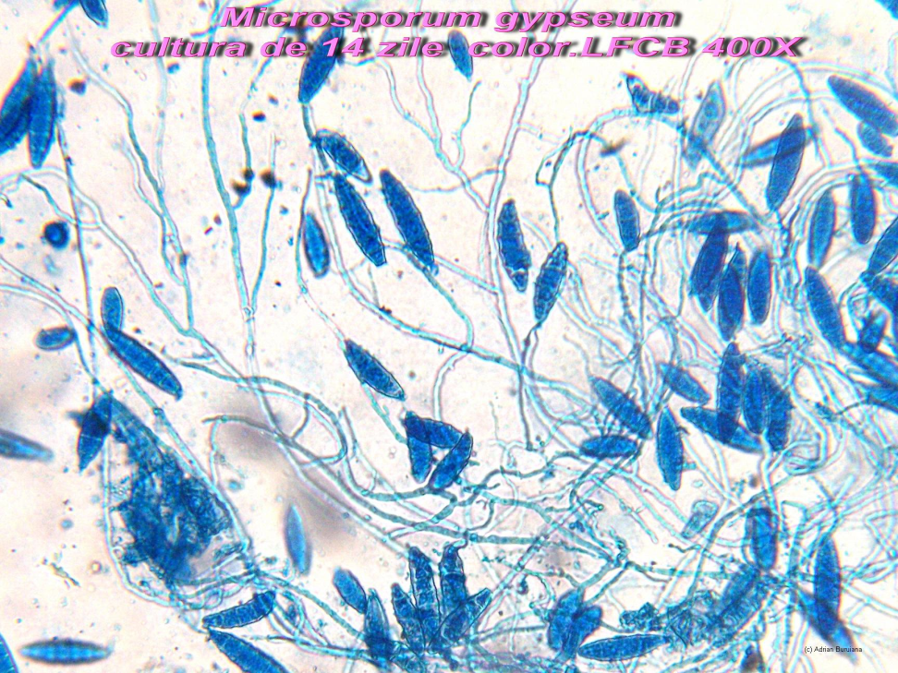
Microsporum gypseum

Slide 105
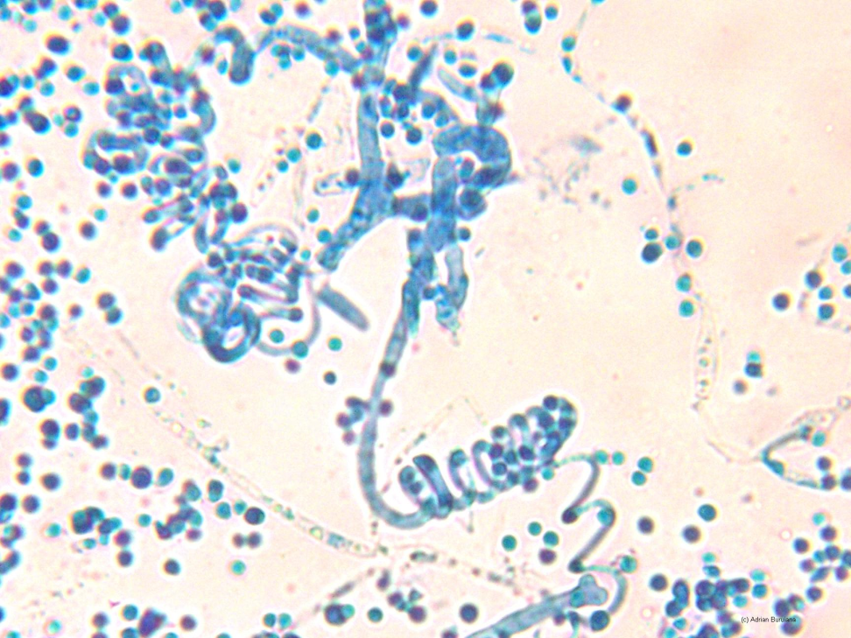
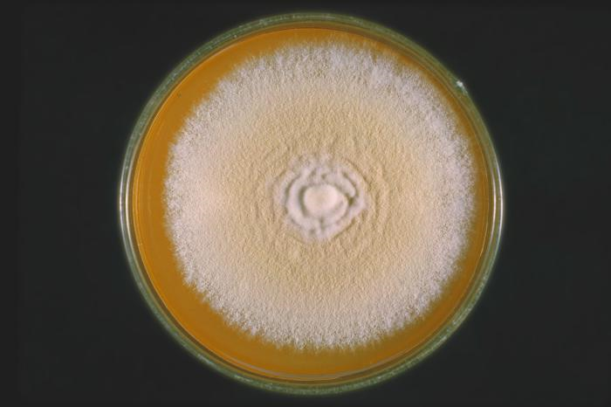
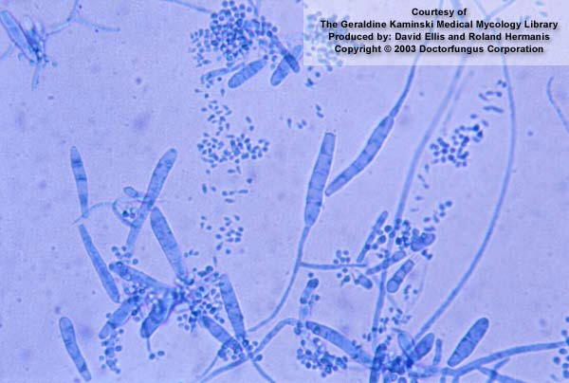
Trichophyton mentagrophytes

Slide 106
Non-Dermatophyte Testing
Non-dermatophytes are usually streaked out on blood agar or Sabouraud dextrose agar.
Fungi that can invade tissue grow at body temperature (37⁰ C); This temperature inhibits many contaminant saprophytic species.
  Exception: Dimorphic fungi like Blastomyces and Histoplasma spp. grow as yeasts at body temperature and as molds at 25⁰ C.
  Incubate cultures, in parallel, at both temperatures
  Characteristics of systemic dimorphic fungi of veterinary importance are listed in table 4-7.
  Tissue sections showing invasion may be needed for definitive diagnosis of mycotic infection.

Slide 107
Virology
Virologic techniques include histopathologic and serologic examination, electron microscopy, and attempted isolation and identification of the virus.
Serologic tests are available for most viral diseases.
Rising antibody titer indicates recent infection by the virus.
Virus isolation is expensive and time consuming and may provide a diagnosis only after the animal has recovered or died.
  Is most successful when specimens are collected early in the active infectious phase.

Slide 108
Virology
Viruses vary greatly in ability to remain viable in tissues and exudates
  Often present in the nasal or pharyngeal secretions early in the acute stage of respiratory diseases
Viral diseases often are complicated by pathogenic bacteria acting as secondary invaders.
Samples for virology testing must be collected aseptically, kept at 4⁰ C, and taken to the laboratory in the shortest time possible.

